Slide 2
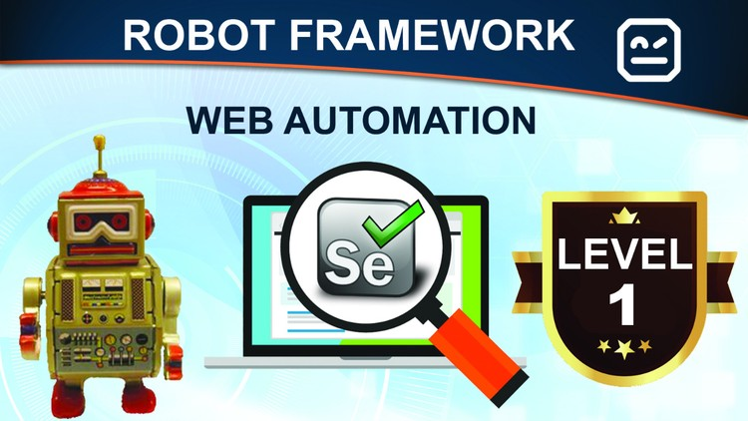
RF + selenium

Slide 3
Agenda
Automation overview
Architecture
Robot framework Libraries
Automation Process
POM Model
Different framework Models

Slide 4
Robotic process Automation (RPA)
RPA solution that is used to automate business processes.
we can automate Web app ,Mob app, REST API
Can be integrated with Jenkins, Docker virtually any other tool to create powerful and flexible RPA solutions.
Open source automation framework for Acceptance testing
Robot Framework is operating system and application independent.
Core frame work is implemented using Python
RF provides good support for external libraries, tools that are open source and can be used for automation.
Most popular library used with Robot Framework is Selenium Library used for web development & UI testing

Slide 5
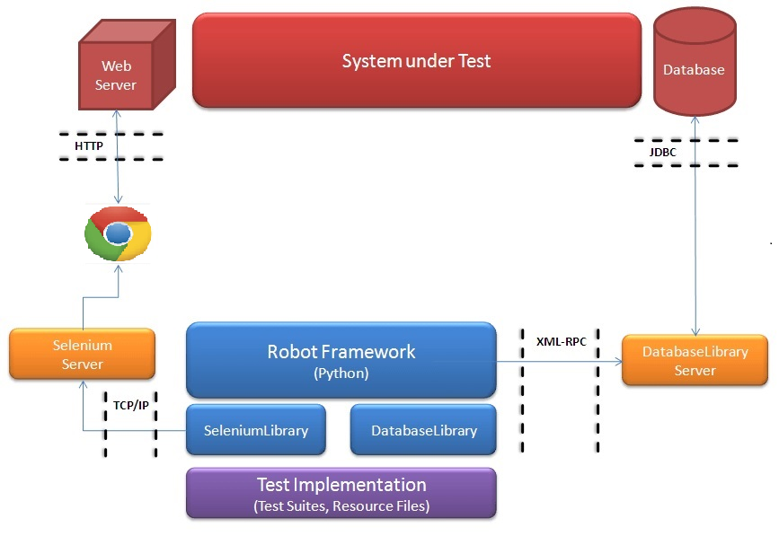
Robot Framework - Testing Architecture

Slide 6
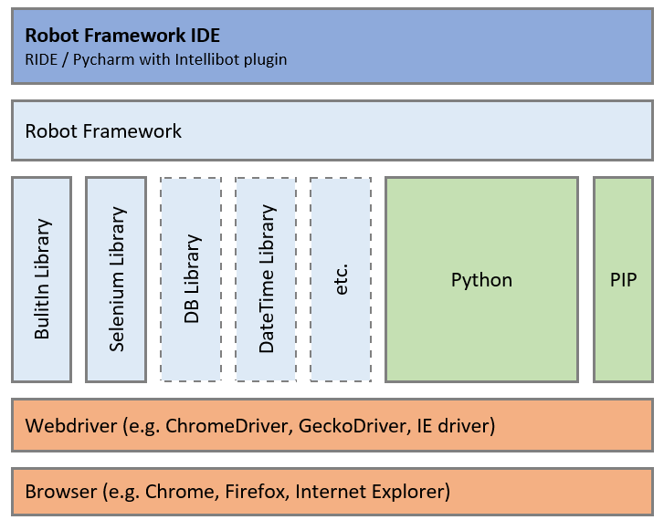
RF Library

Slide 7
Build in –standard library
String generating, modifying and verifying strings
Date Time
Collections lists and dictionaries
Screenshot
Operating System

Slide 8
External library (UI Automation)
Selenium Library
ExtendedSelenium2Library internally, providing AngularJS support on top of it.
Database Library (Python) database testing. Works with any Python interpreter, including Python
MongoDB library Library for interacting with MongoDB using pymongo.
SSHLibrary executing commands on remote machines over an SSH connection. Also supports transferring files using SFTP
HTTP library (Requests) Library for HTTP level testing using Request internally

Slide 9
External library (API Automation)
HTTP library (Requests) (Library for HTTP level testing using Request internally.)
JSON library (JSON validation based on JSONSchema)

Slide 10
External library (Mobile Automation)
AppiumLibrary (Library for Android- and iOS-testing. It uses Appium internally.)

Slide 11
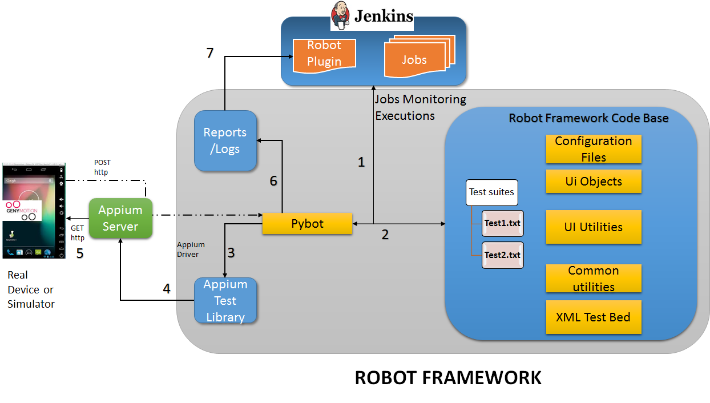
Framework structure and process

Slide 12
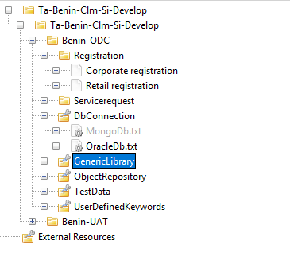
RF project structure

Slide 13
RF different framework model
keyword-driven.
data-driven.
This is the keyword name we used to perform the appropriate action.
web element value From the OR (identification of web objects).
Test i/p values form test data folder.

Slide 14
Keyword driven
Keywords | Web element | Test data
Open Browser | ${URL} | ${BROWSER}
Maximize Browser Window
Input Text | ${LoginUserName xpath} | ${Username}
Click Element | ${LoginSubmit xpath}
Close Browser
Close the Aleart box

Slide 15
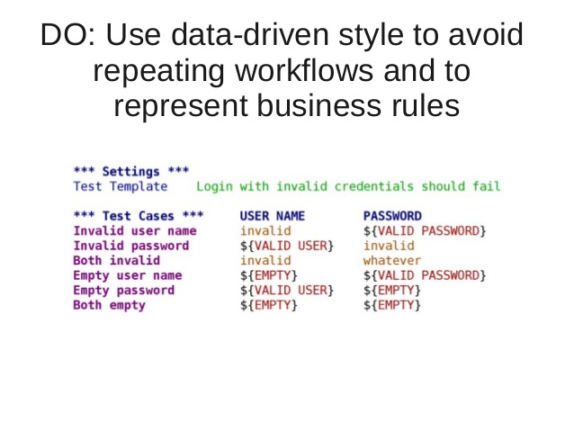
Data driven

Slide 16
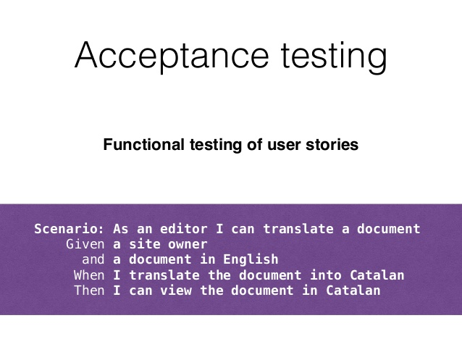
Acceptance test driven

Slide 17
Robot framework DEMO
Create Project
Create Test suite
Create testcase
How to write test scripts
Create object repository
Create User define keyword
Test data (Static /dynamic)
Execution ,logs and Report

Slide 18
Robot Framework Setup Requirements
Requirements | Remarks
Windows Environment | OS: Windows 7 (32 or 64 bit) or 10 (64 bit) RAM: 2 GB CPU: 2 cores HDD: 40 GB
Python | python-2.7.12.msi
Package management system to install and manage software packages written in Python | pip
wxPython - A wrapper for the cross-platform, GUI API toolkit wxWidgets | wxPython2.8-win32-unicode-2.8.12.1-py27.exe
VCForPython - Microsoft Visual C++ Compiler for Python 2.7 | VCForPython27.msi
Oracle Database Client | Oracle Client 11.2 & above
Robot Framework (Python Package) | Robot Framework 3.0.2
Robot framework Libraries and Other Python Packages | Refer next slide
Web Browser Drivers | Chrome -> chromedriver.exe (v 2.33) Firefox -> geckodriver.exe (v 0.18.0)

Slide 19
Q&A

Slide 20
Thank you!

